Slide 1
542 Project and Testing
Poker Hand Evaluation
Abraham Ludlam
Hezekiah Pilli

Slide 2
Our Program
We found a poker hand evaluation project on github and decided to use it for this project
https://github.com/fogleman/Poker
It provided evaluations for randomized hands for two players for both 5 card poker and texas hold’em style 7 card poker.
We added the functionality for three players for 7 card evaluations and also added a basic interface to be able to run these evaluations as much as the user wanted.
https://github.com/AbeLudlam/542Poker

Slide 3
Project Versions and Case tools
Python 2.7.6
Pytest 3.10.1
Python’s UnitTest framework

Slide 4
Testing Focus
We focused on testing the individual evaluation functions of the program for 5 card and 7 card poker, eval5() and eval7().
These were the two most important and portable functions of the entire program. All other functions were simply ways to display the results of these two functions.
These functions are also the ones that would be implemented for an actual poker program to decide who has the best hand at the end of a round.

Slide 5
How Eval5 and Eval7 work
These evaluation functions work by looking at the inputted hand and give back a score based on how good it is, the lower the better.
Eval5() works by scoring the 5 cards in a player’s hand, while Eval7 works by scoring all combinations of 5 of the 7 cards sent to it (5 from the community pool and 2 from the player’s hand) and returning the lowest one.

Slide 6
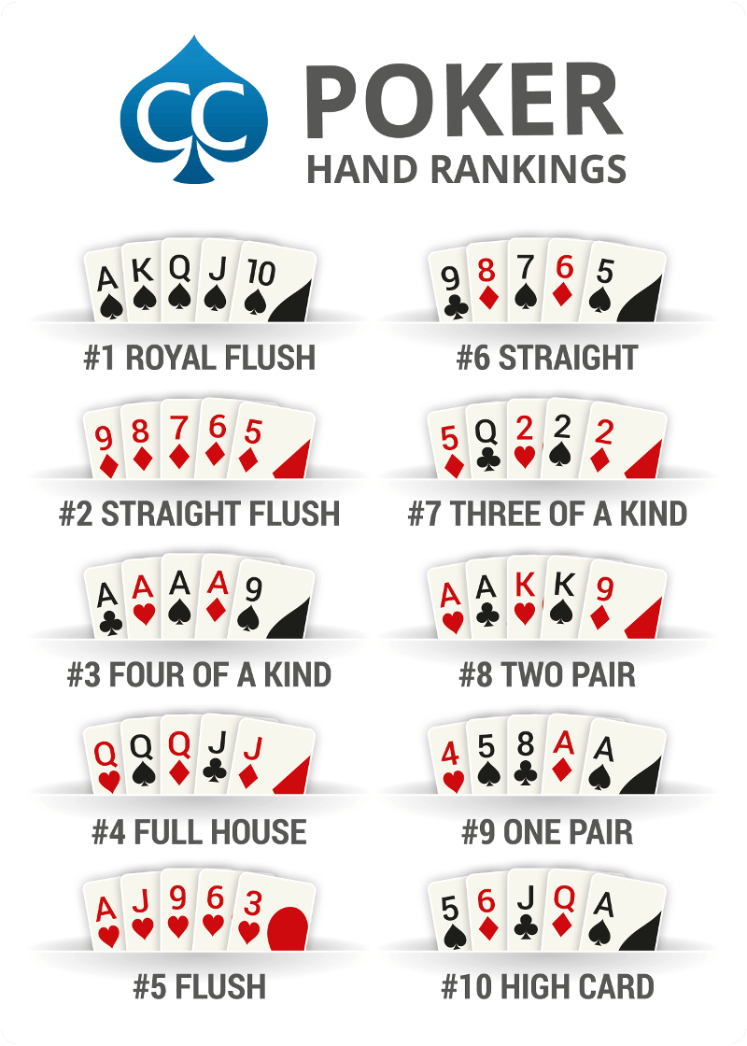
Hand Rankings and Combinations
- For testing Eval5() and Eval7() we need to keep hand rankings in mind.
- Due to the scoring nature of the evaluation functions and the hand rankings have a clear defined order, it led us to use equivalence class testing.
- We tested each group of rankings to make sure it had a lower score than the ranking below it. We also tested ties for the four categories of hands (High card, Pairs, Flushes, and Straights)
- Without equivalence class testing, the total number of hand comparisons that can be done is 2,598,960 x 2,598,959 = 6.7545905e+12
Hand Ranking Chart - https://www.cardschat.com/poker-hands.php

Slide 7
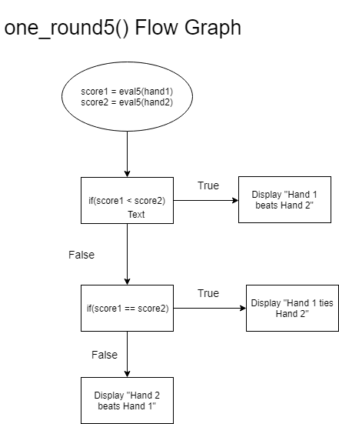
Other Tests
- Quality tests that check to make sure that the evaluation functions don’t score hands with two or more of the same card. This is done for security reasons to indicate nefarious changes to the given hands. Currently these tests fail as the functionality to recognize identical cards is not implemented currently.
- Due to their current implementation, stubbed out versions of the functions that call the evaluation functions were made. These stubbed versions were used to test that logic flow was implemented currently so that the correct winner is displayed.

Slide 8
Areas of Improvement
-To improve the current program, we would implement hand checking so that the eval5() and eval7() would not give scores for invalid hands.
- Change the functionality of the the one_round functions so that stubs are no longer necessary.
-Create our own function to get user input for using the evaluation functions so that user inputs can be automatically tested.
-From there, try to implement the evaluation functions in an actual poker program

Slide 9
Lessons Learned
We learned that we should strive to write code that is easily testable, as it creates more work for the tester and developer if the code generates any errors.
Recognize what parts and functions of the code deserve priority during testing. Treating a display function with the same priority as a function that performs the most important process of the code leads to not enough tests covering the requirements.
Know when to use different methods to test a feature.

